Slide 1







Technology Trend Analysis
Y Nguyen
March 10, 2023

Slide 2



OUTLINE
Executive Summary
Introduction
Methodology
Results
Visualization – Charts
Dashboard
Discussion
Findings & Implications
Conclusion
Appendix

Slide 3

EXECUTIVE SUMMARY
Current Technology Usage
Top 10 Language
Top 10 Database
Platform
Top 10 Webframe
Future Technology Trend
Top 10 Language
Top 10 Database
Platform
Top 10 Webframe
Demography Survey
Respondent by Gender
Respondent by Country
Respondent by Age
Respondent by Gender and Education

Slide 4

INTRODUCTION
Analyze technology trend in language, database, platform, and webframe. The analysis also performs the demography of responding to technology.
Purpose of this analysis
Identify top 10 programming languages, databases, platform and webframes skills mostly using.
Identify top 10 programing languages, databases, platforms, and webframe mostly used in future.
Explore the demographics by gender, age, country, and education
Audience
IT students, developers
People who is interested in IT
Data analysts
Tech Companies

Slide 5

METHODOLOGY
Data Collection
Sources from Stackoverflow
Using 2 datasets:
m5_survey_data_demographics.csv
m5_survey_data_technologies_normalised.csv
Visualization using IBM Cognos
Presentation

Slide 6
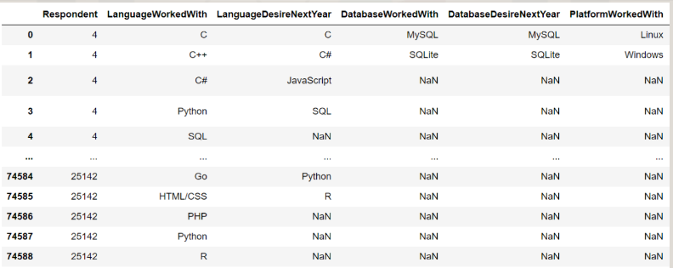
RESULTS
The results may not correct deal to the uncleaned datasets. So this analysis is just for a quick view of trends.

Slide 7
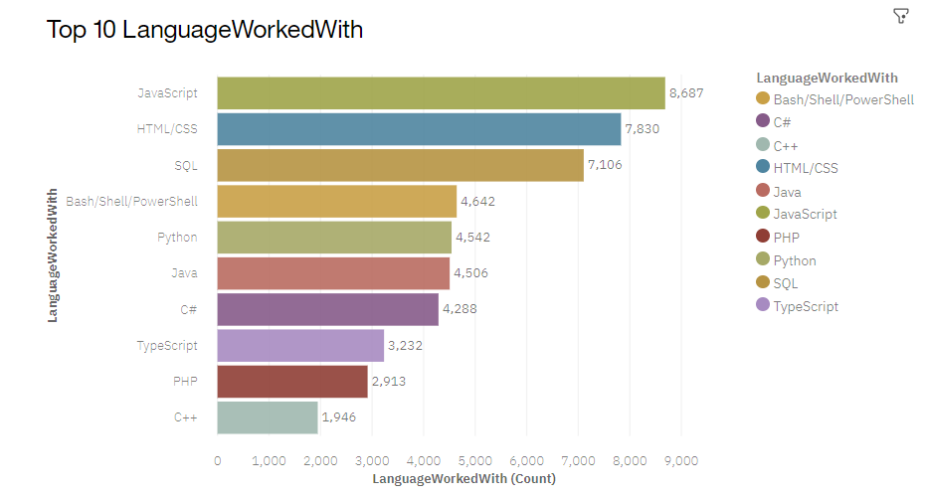
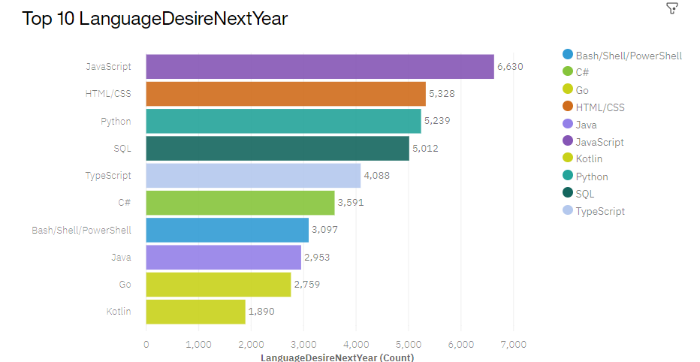
TOP 10 PROGRAMMING LANGUAGE TRENDS
Current Year
Next Year

Slide 8
PROGRAMMING LANGUAGE TRENDS - FINDINGS & IMPLICATIONS
Findings
Javascript and HTML/CSS are in top trending of programming language.
Python will be a most used in future
C++ is using less and it may not be used popularly in future
Implications
The web developments are still in high demands
Potential of AI- driven development
Close to C, and complicate to learn

Slide 9
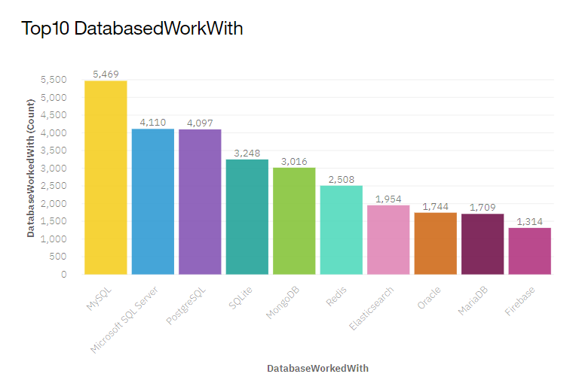
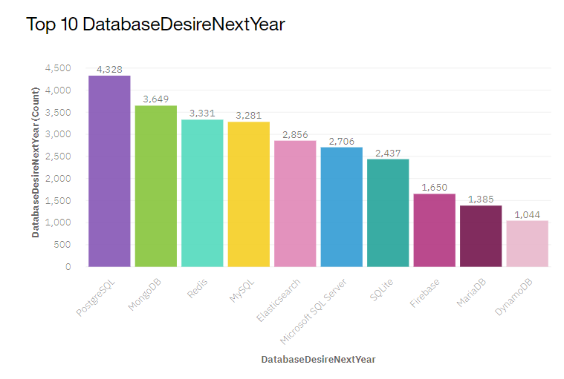
TOP 10 DATABASE TRENDS
Current Year
Next Year

Slide 10
DATABASE TRENDS - FINDINGS & IMPLICATIONS
Findings
MySQL will be replaced by PostgreSQL in future
The significant change in use of databases
MongoDB and Redis are the most favorable NoSQL database
Implications
The support application features of PostgreSQL more than on MySQL
Developers seems to find the tool that more easier and convenient to use
NoSQL may make impact on rational database

Slide 11

DASHBOARD
<The permanent link of the read-only view of the Cognos dashboard goes here.>
https://dataplatform.cloud.ibm.com/dashboards/d2564013-7ad1-4cc4-9e31-d7ce3f798510/view/5f63c5022fbd1fd312f7eae4079e2d577f61260ce0bbd70583877b4907342397f0614298c8261e0c8f470567a5ba415c9d

Slide 12
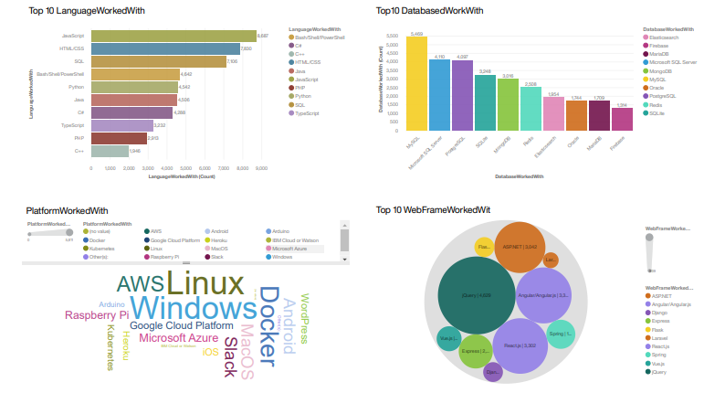
DASHBOARD – Current Technology Usage

Slide 13
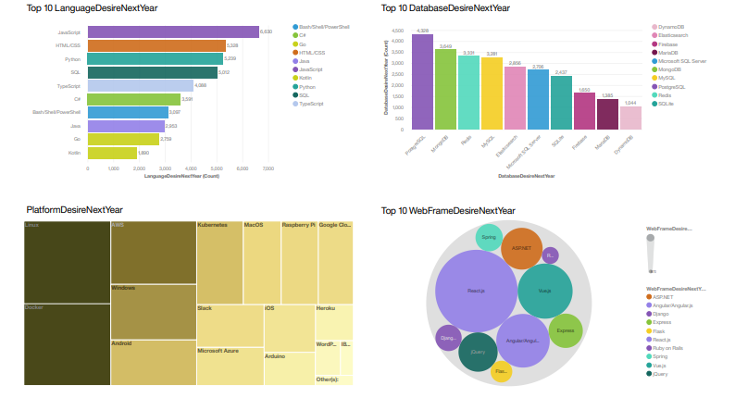
DASHBOARD -Future Technology Trend

Slide 14
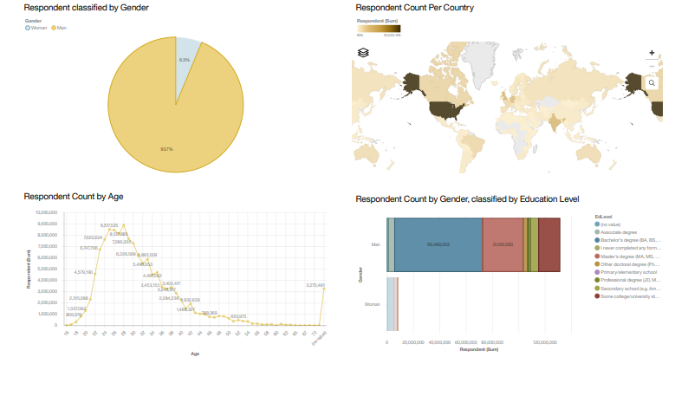
DASHBOARD - Demographics

Slide 15
DISCUSSION
Technology Usage Now & Future
Gender, Age, Country, and Education in IT industry

Slide 16
OVERALL FINDINGS & IMPLICATIONS
Findings
Technology is changing and developing everyday
USA is still the top country in tech
The big difference in distribution of gender in tech.
The peak of age in tech between 24 and 36 year old
Implications
IT require people who is in need to improve the skills and knowledge day by day
Gender should not be a big bap in between in tech. There should be more associations for women.

Slide 17

CONCLUSION
The analysis giving a clear points of how usage and trending in programming languages, database, platform, and webframe. We will have a better picture of what tools and app usage now and future usage so that student/ developer/ tech companies will have better strategies for their option insider.

Slide 18

APPENDIX

Slide 19
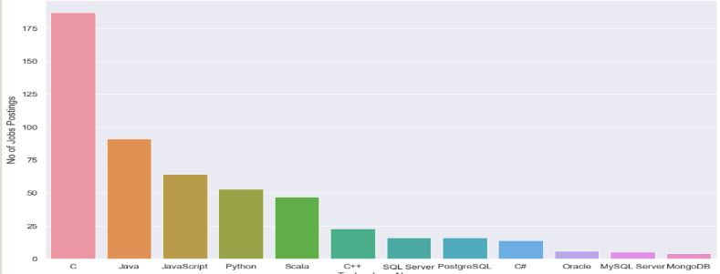
JOB POSTINGS

Slide 20
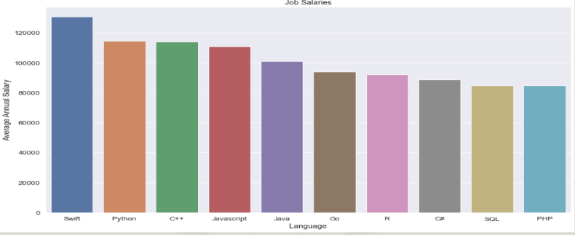
POPULAR LANGUAGES

